Slide 1
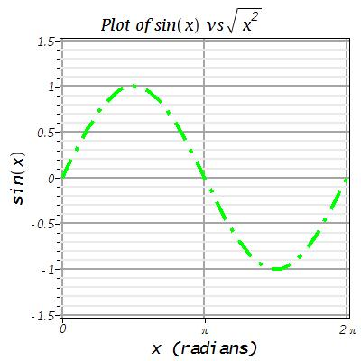
Import of the Maple-generated “sinPlot.jpg”.

Slide 2
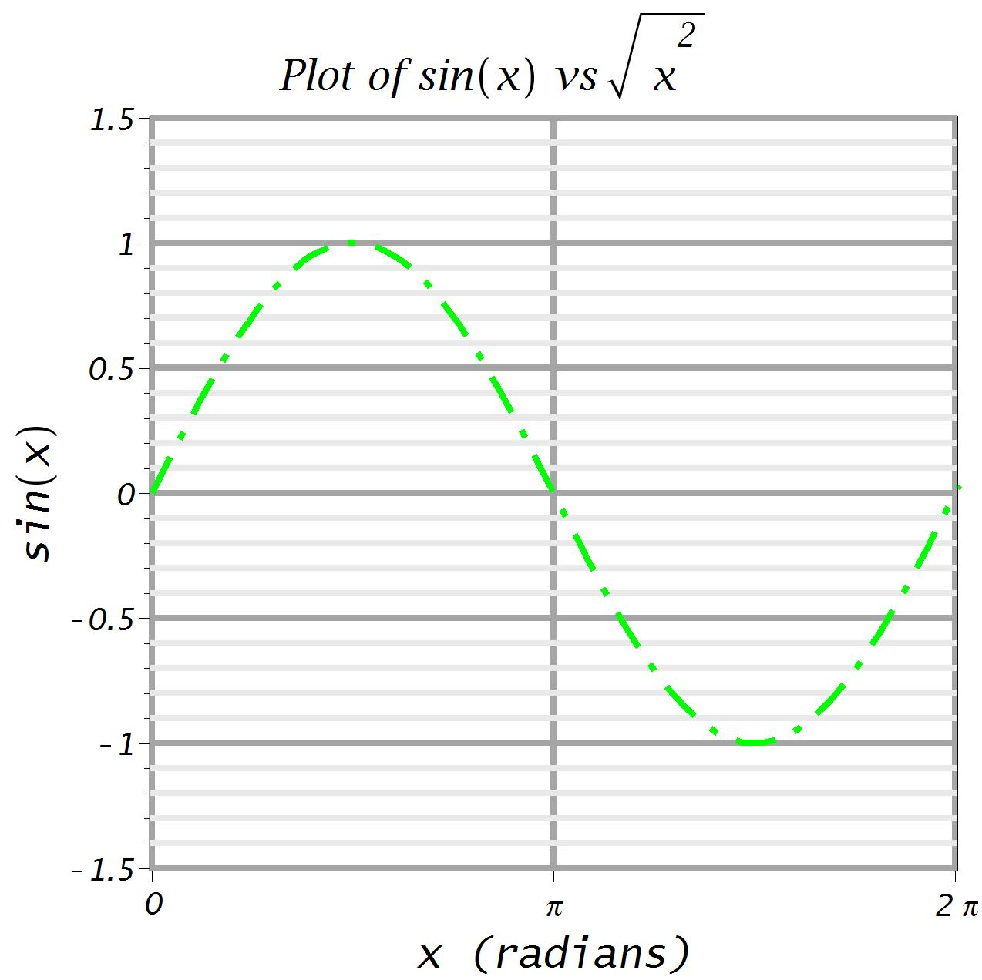
Import of the Maple-generated “sinPlotLarge.jpg”.
Require the large plot to achieve reasonable resolution for presentations.

